Slide 1
Machine Learning for Linear Solver Selection
By: Wes Ludwig + Max Oellien

Slide 2
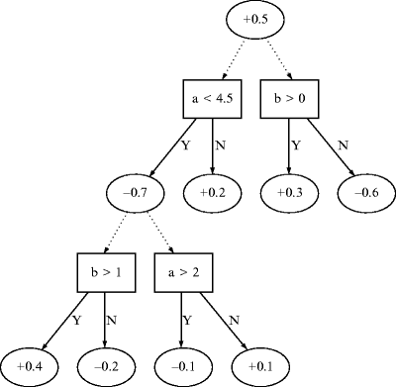
Project Premise
To recreate the work of Eijkhout, Bhowmick, et al (2008) by creating an alternating decision tree (ADT) which classifies linear systems using their calculable system characteristics as defined in the work leading to the Numerical MetaData (NMD) descriptor language.
Classes correspond to combinations of PETSc solvers, preconditioners, and their possible options. An ADT for these classes then, is able to suggest a best-choice solver, preconditioner, and their options.
Schematic of an alternating decision tree:

Slide 3
Project Goals
To create a proof-of-concept program which creates a functional ADT which can suggest between two system-solver classes using two linear-system features computed by NMD-anamod.

Slide 4
Machine Learning Principles
AdaBoost - popular boosting technique, combine multiple weak classifiers
Random guessing < weak classifier < strong classifier
Technique that builds on top of other classifiers as opposed to being a classifier itself.
Chooses the training set for each new classifier that you train based on previous classification
Determines how much weight should be given to each proposed answer

Slide 5
Machine Learning Principles
Decision Trees
Split on features, stop on leaves
We want the smallest tree because Mr. Occam says so
Start with the “best” feature at the top and then the next “best” and then the next “best”
Good idea?
NOT NECESSARILY!
We reinforce optimal conditions via purity checks

Slide 6
Information Purity
First, let p represent the proportion of instances that belong to the positive class
Entropy: Σ -p * log₂(p)
Information Gain (X ) = Entropy before - Expected entropy after

Slide 7
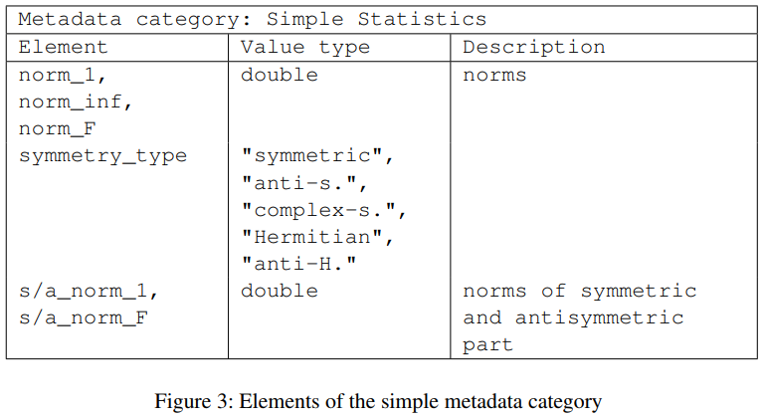
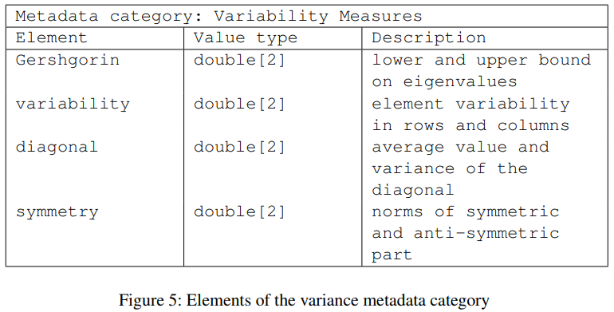
Linear System Features
-Descriptive values can be computed for individual matrices and larger linear systems
-For different solvers, certain features will be more important to consider
-We can use NMD-AnaMod to compute these features

Slide 8
Progress
Machine Learning:
Using SciKit-ML
Successfully implemented adaboosted ADT in Python
Waiting on features and performance data for training
Feature Computation:
Installed NMD and AnaMod
Wrote C code to compute features for example matrices
Working on getting it to compile

